Slide 1
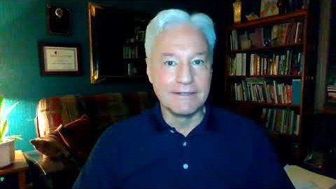
CHAPTER 5
Attraction, Arousal, Response, and Sexual Orientation

Slide 2
Senses Involved in Sexual Arousal
Haptic (touch) sense of the body contains different nerve endings on different types of skin.
Consciously detectable smells can evoke powerful memories and associations and lead to arousal.
Basic sensations of taste are limited to salty, sour, sweet, bitter, spicy/burning, and umami.
Sound can be arousing with regard to tone of a voice.
Cultural and individual differences play a role in determining arousal or aversion of inputs.

Slide 3
Reflex Responses and Nervous System Loops
Sexual arousal has three related paths in the body:
  From the genitalia to the spinal cord and back.
  From the genitalia to the brain via the spinal cord:
    Bringing signals to the central nervous system.
  From the brain to the genitalia via the spinal cord:
    Bringing signals from the central nervous system out to the body.
Arousal can occur from direct stimulation to the genitalia or from thoughts and associations.
Nervous system has multiple branches:
  Somatic nervous system: voluntary
  Autonomic nervous system: involuntary
    Sympathetic division
    Parasympathetic division

Slide 4

Hormones and Neurotransmitters
Hypothalamus: brain structure that is part of the limbic system which includes processes related to fear and arousal.
Neurotransmitters involved in sexual response:
  Dopamine: associated with reward.
  Oxytocin: associated with non-romantic and romantic bonding:
    Involved in physiology of orgasm, childbirth, and lactation.

Slide 5
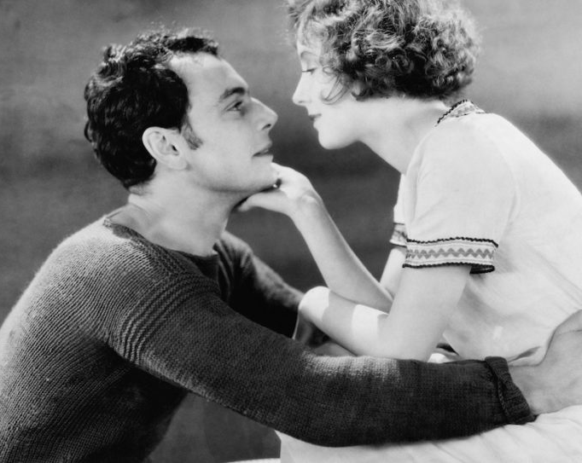
Sex Hormones, Sex Differences, and Arousal
Removal of testicles or the blocking of testosterone by anti-androgen drugs, is associated with a decrease in sexual interest:
  Adding testosterone raises sexual interest and ease of physical arousal in both sexes.
Some females experience change in levels of desire and frequency of arousal during menstrual cycle.

Slide 6
Four-Phase Sexual Response Model of Masters and Johnson

Slide 7
Sexual Response Model of Walen and Roth

Slide 8
Sexual Excitement and Genital Arousal
Arousal is accompanied by a release of acetylcholine in nerves that enervate arteries supplying blood to the erectile tissues.
When stimulation ends, or orgasm occurs, cyclic guanosine monophosphate (cGMP) production is reduced:
Leads to cGMP being metabolized by enzymes such as PDE-5, and erection ending.

Slide 9

Orgasm
  Sensation of muscular contractions and the feeling of a release of tension in the body:
    Prolactin is released in the brain after orgasm.
  Males experience a refractory period between each orgasm:
    Retrograde ejaculation: ejaculation occurs but the bladder neck does not close off, and so part or all of the ejaculate enters the bladder instead of the urethra.
    Some males are able to experience multiple orgasms.

Slide 10
Female Ejaculation
  Types of female ejaculate:
    Cloudy alkaline gel-like substance, expelled from the urethra and produced by Skene glands.
    Clear liquid forcibly ejected from the vagina during orgasm.
    Some women ejaculate, and some do not.

Slide 11

Lifespan Changes
Lifespan of a sexual arousal cycle decreases with age:
  Lessening in the strength of genital arousal.
  Reduction in vaginal lubrication.
  Lessening in the intensity of ejaculation.
  Muscular contractions associated with orgasm.
  Faster decline in arousal after orgasm.
  Increase in refractory period for males.
  Increase in interval between resolution and next arousal for females.

Slide 12
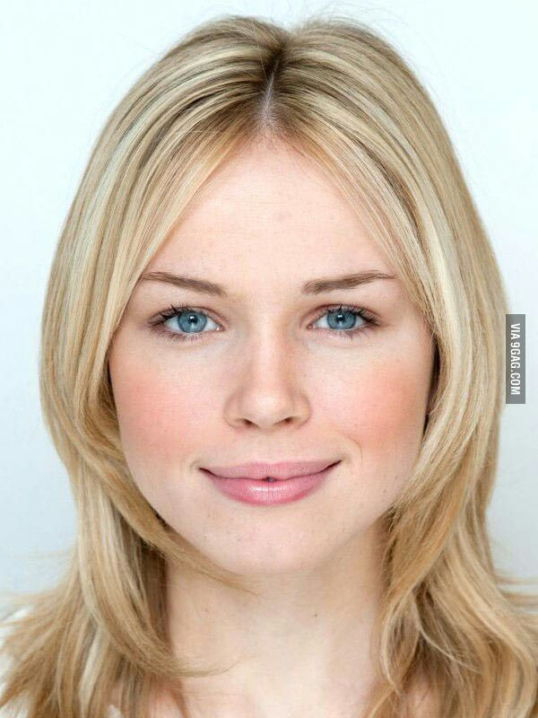
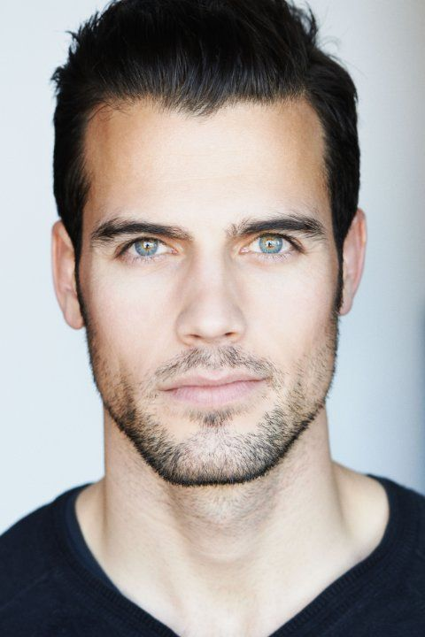
Facial Symmetry and Femininity/Masculinity
Cultures have similar opinions on facial attraction, which becomes more pronounced with concerns of the onset of disease.
Individuals who have a face that is more clearly masculine or more clearly feminine are judged as being more attractive.

Slide 13
Hot or Not?

Slide 14


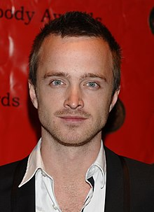
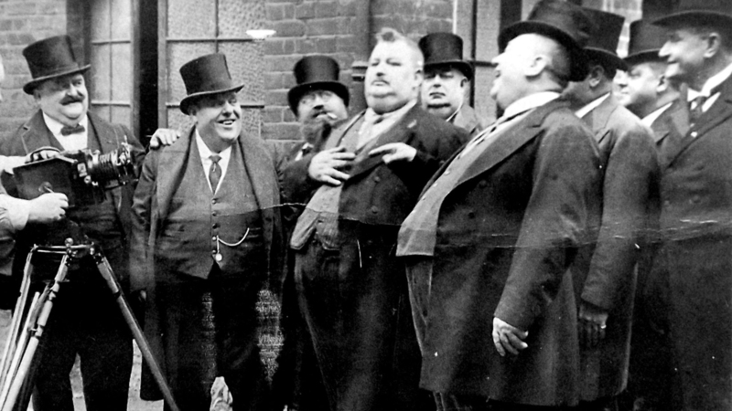
Other Aspects of the Body
Attractive body weight varies by culture and historical era.
Baby-facedness in adults is a characteristic that is deemed attractive:
  Involves a relatively round head, large eyes, large mouth, and small nose.

Slide 15

Smell
Pheromones: signaling chemicals that affect behavior in animals:
  Play a reduced role in human sexual behavior
Histocompatability complex (MHC): immune system functioning:
  Also called the human leukocyte antigen (HLA)

Slide 16
Hormones
Sex hormones affect attractiveness in a permanent fashion in both sexes through masculinization or feminization of the face and body.
Oxytocin: serves multiple roles in the brain and body including effects on orgasm, attraction and attachment:
  Secreted by both the hypothalamus and pituitary gland.
  Stimulates uterine contractions during orgasm.

Slide 17
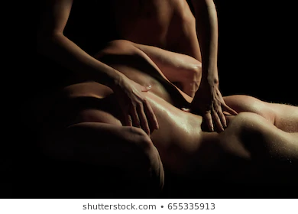
Context and Familiarity
Habituation: familiarity with stimuli produces a reduced response:
    Repeated presentations of the same erotic image can be accompanied by reduced arousal.
Familiarity can produce liking.

Slide 18
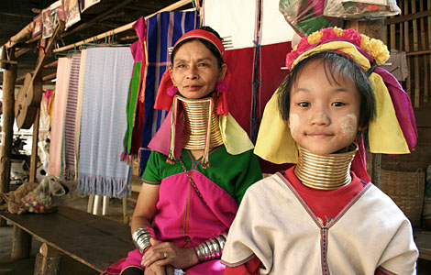
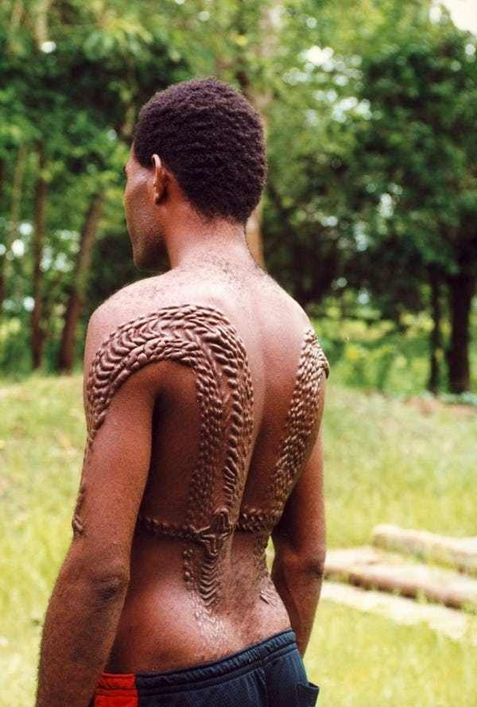

Culture-Specific Attraction
In many cultures, sex-specific body adornment or modification may reflect and shape societal gender roles:
  Sometimes involving functional impairment.
Bodily modifications that fall primarily on one sex and not the other frequently typically reflect and reinforce culturally-learned gender roles.

Slide 19
Research Focus
Rozin, Haidt, & McCauley, 2000:
  People were asked if it was wrong to buy a dead chicken in a supermarket and have sex with it before cooking it:
    Things that activate a sense of disgust tend to produce moral outrage even when the activity is morally neutral.
    Explains the outrage felt by people raised in religious traditions when confronted with their own sexual arousal, or to same-sex intimacy.

Slide 20


Sexual Orientation
Biological sex and gender identity of the people to whom someone is typically sexually attracted, including aspects of:
  Physical attraction
  Emotional and romantic attraction
  Sexual behavior
  Aspects of self-identity related to the pattern of one’s sexual attractions

Slide 21
Asexuality
People who do not experience any significant sexual attraction to either sex:
  Some asexual individuals do enjoy masturbation but have no attraction to others.
  Some desire an emotionally intimate relationship which may include marriage but limited or no physical intimacy.

Slide 22
Orientations and LGBTQQI2SAAPSGLHS
Heterosexual bias: assuming that people are a particular sexual orientation
LGBTQQ:
  Lesbian: females who are attracted to females.
  Gay: males who are attracted to males.
  Bisexual: attracted to both the sexes.
  Transgender: gender identity different from apparent outward biological sex.
  Queer
  Questioning: uncertain of their attraction.

Slide 23

Orientations and LGBTQQI2SAAPSGLHS
(alphabet soup)
LGBTQQI2SAAPSGLHSC
  Intersex
  2-spirited: variety of gender identities and sexual orientations.
  Asexual
  Allies: heterosexual person who is very supportive of nonheterosexuals.
  Pansexual: experiences attraction primarily to personality characteristics and not on the basis of someone’s sex.
  Same-gender-loving.
  Heterosexual: attraction to people of the other biological sex / gender-identity, or female-male attraction.
  Straight.
  Cisgender: gender identity and outward sex being concordant.

Slide 24
Multiple Meanings and Measures of Orientation
Different scales used to measure sexual orientation:
  Kinsey scale: 0 Exclusively heterosexual to 6 Exclusively homosexual
  Klein sexual orientation grid (KSOG).
  Penile or vaginal/clitoral plethysmograph.
Different patterns of activation:
  Auditory system reacting to the biological sex of a speaker.
  Visual system reacting to faces.
  Brain centers associated with genital arousal reacting when viewing erotic material.

Slide 25
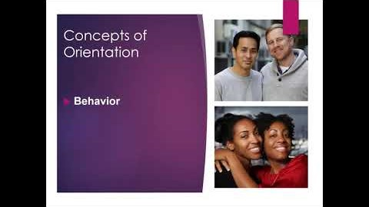

Slide 26

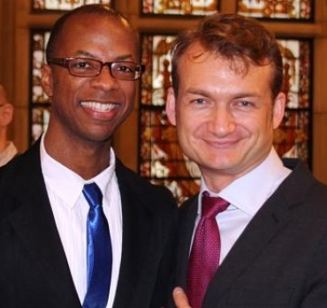

How Common Are Various Sexual Orientations?
Lifetime behavior and self-identity suggests that for some people sexual experience occasionally departs from their predominant sexual orientation.
Bisexuality identity in males is accompanied by a distinct arousal pattern to both sexes.
Situational homosexuality: same-sex behavior when partners of the preferred sex are not available (prison; single sex school; armed services).
Sexual behavior, whether with someone of the same sex or other sex, may occur as part of:
  Friendship
  Physical and emotional attraction
  Sexual exploration
  General arousal
  Specific sexual interest
  Response to situational constraints

Slide 27
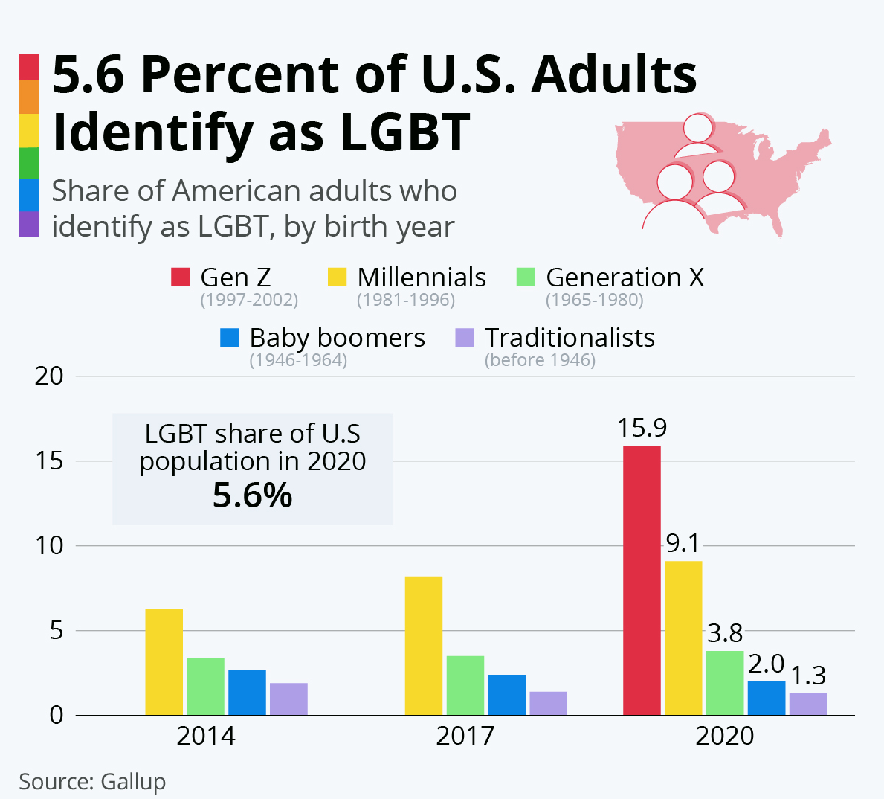

Slide 28
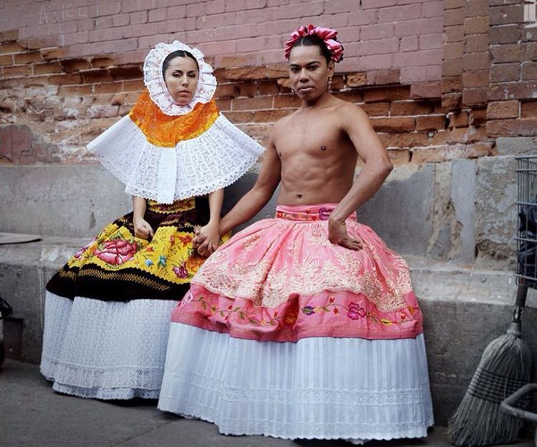


Sexual Orientation in Nonindustrial Cultures
Pre-industrial societies have a single category that encompasses all variations in sexual orientation, gender identity, and gender role conformity.
In postindustrial societies there were many same-sex attracted people concentrated in urban locations:
  Ability to have sufficient numbers to form cultural groups within the larger culture.

Slide 29
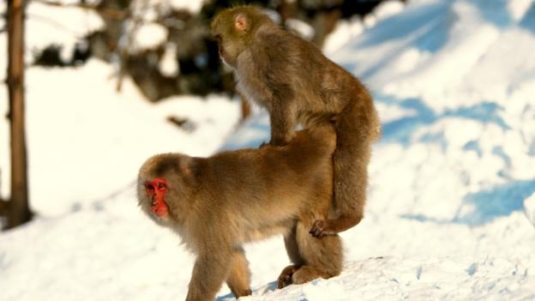
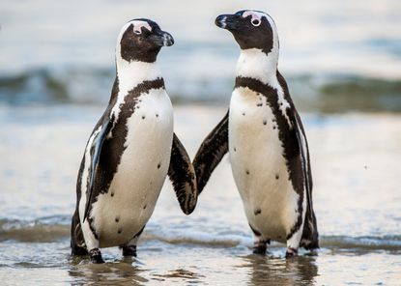
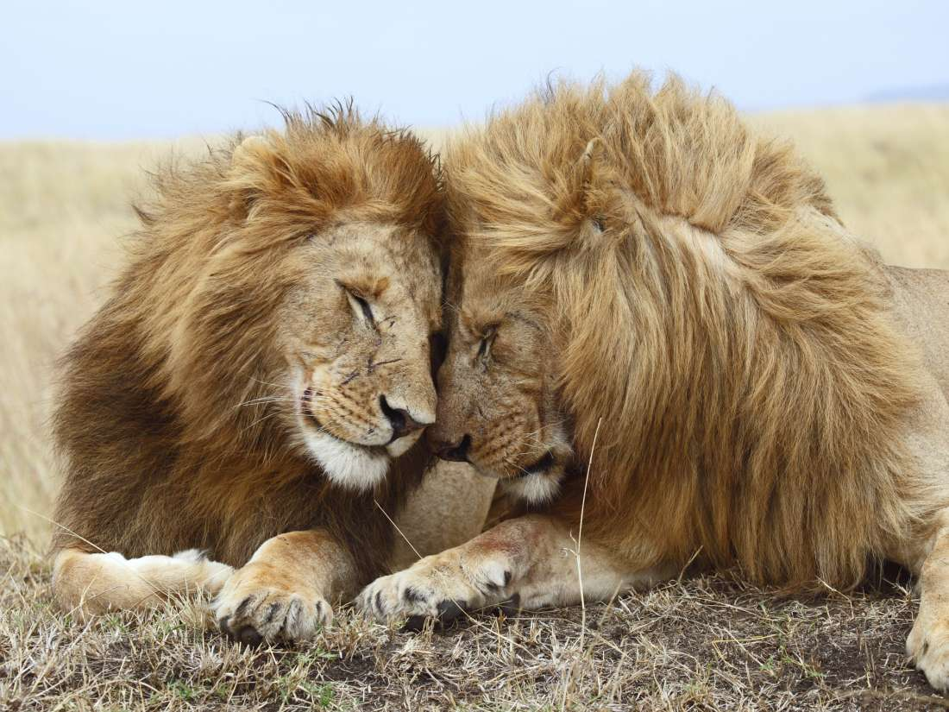
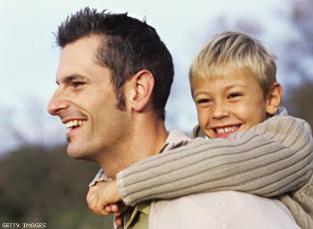
Sexual Behavior in Other Animals
Same-sex mating behavior and social pair bonding are observed in many species of birds, mammals and reptiles.
Gay uncle or aunt: person who did not have offspring of their own but who was highly involved in raising related offspring, would have an evolutionary benefit offsetting the decrease in individual reproduction.

Slide 30
Sexual Orientation and the (Human) Brain
There exists a relationship between biological sex, exposure to androgen levels during development, and the organization of brain structures:
  With significant correlations between biological sex, gender-typical behavior and sexual orientation.

Slide 31
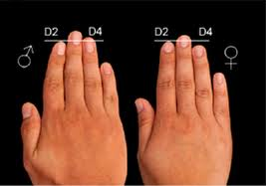
Sexual Orientation and Fetal Androgen Exposure
Digit ratio: relative length of the second finger (index finger) to the fourth finger (ring finger).
High levels of exposure in fetal development to estrogen have been associated with same-sex attraction in adult females.
Experiences in childhood and adolescence may influence the development of specific sexual interests that people form.

Slide 32
Factors Affecting Orientation
Genes
Higher presence of an allele known as Xq28
Possible immunological role

Slide 33

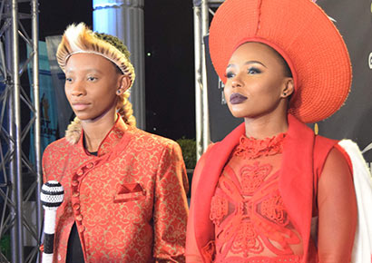
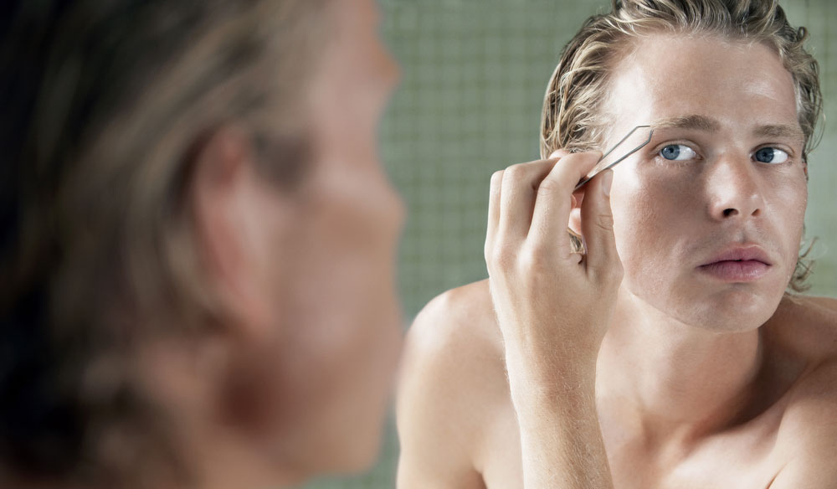
Putting It All Together
Three separate aspects to sexual development:
  Gender identity
  Capacity for forming relationships with others
  Direction of sexual responsiveness
Most males are attracted to females as adults regardless of their early experiences, while females in many cultures experience a wider range of attractions.

Slide 34
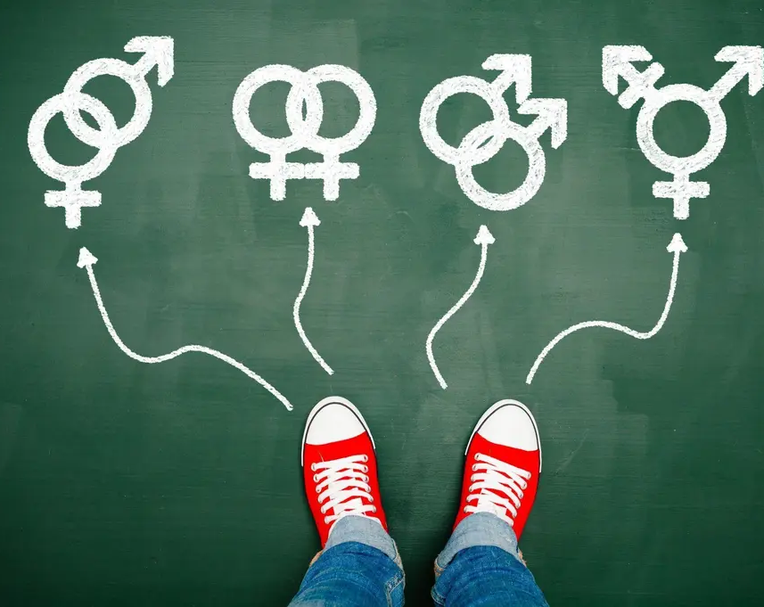
How Fluid Is Sexual Orientation?
Most females experience genital arousal to a wide variety of sexually explicit stimuli.
Sexual fluidity: actual change in patterns of desire and attraction, which occurs in only some people and partly as a result of experiences.

Slide 35
Widely Differing Laws on Sexual Orientation

Slide 36
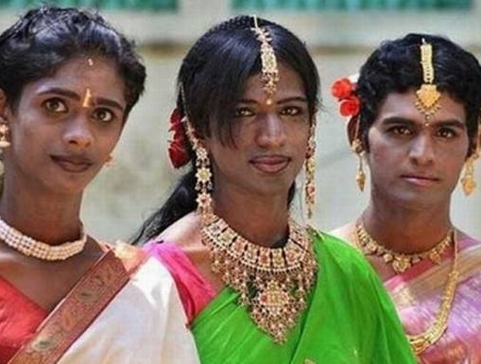

Historical Views on Sexual Orientation
In some cultures, heterosexuality and non-heterosexuality were viewed as neutral or equally permissible.
Many cultures have a third gender or third sex category for individuals who may be atypical in sexual anatomy:
  Hijra in India
  Fa’fafine in Samoa

Slide 37
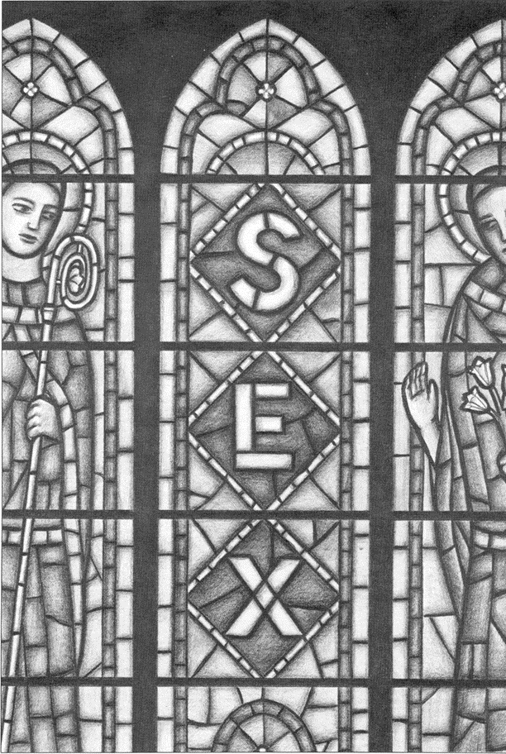
Religious Traditions on Sexual Orientation
Depending on the tribe or nation, people around the world are value-neutral or positive with regards to variations in sexual orientation.
The closet: need to conceal same-sex attraction:
  To avoid social stigma, punishment, or other negative consequences.

Slide 38
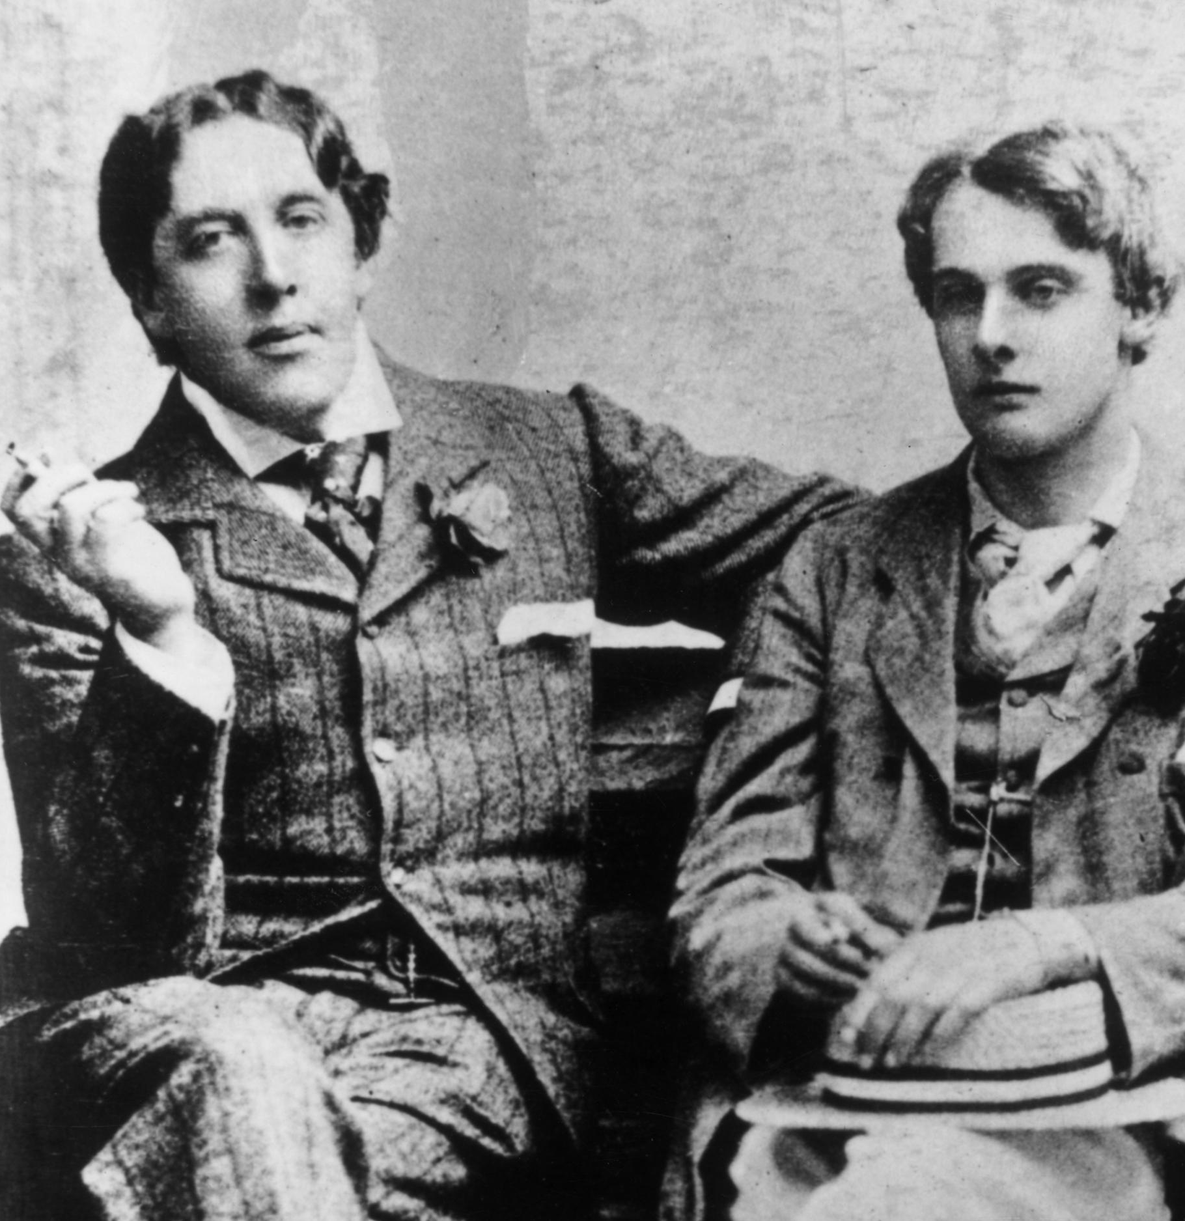
Laws, Psychiatry, and Sexual Orientation
Gay rights movements, along with equality for other non-heterosexuals dates back to the 1800s.
Efforts have been made to repeal laws that discriminated against non-heterosexuals.
Homosexuality was taken out of the APA’s diagnostic and statistical manual in 1973.
Legislation and civil rights efforts have helped bring about change for the equal treatment of gays in many countries.
Same sex marriage was deemed constitutional in the U.S. in 2015.

Slide 39
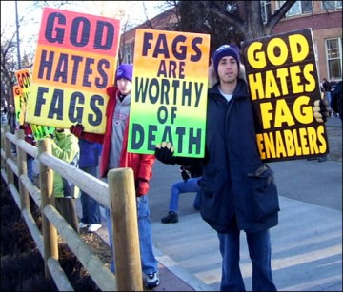
Homophobia and School Bullying
Homophobia: prejudice against sexual minorities:
  Active support of legislation which discriminates against sexual minorities and the opposition to laws which would ensure equal treatment.
Biphobia and transphobia: negative attitudes and prejudice towards bisexual and transgender individuals.
Sexual minorities face challenges related to:
  Rejection by families.
  Conflict between religious beliefs and sexual orientation.

Slide 40

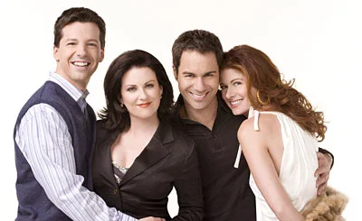


Media and Changing Attitudes
Popular television programs came to feature central characters where orientation was one component of a character:
  Reflected changing attitudes and shaped attitude change in the younger generation.

